Slide 1
백엔드 미니프로젝트 취업사이트

Slide 2
취업게시판 초안
SeekerVO
-num:int
-id:String
-pw:String
-num: int
-name: String
-gen: String
-lang: String
-home: String
-career: int
-divi:String
-filename: String
SeekerDAO
+Insert (SeekerVO vo): int
+update (SeekerVO vo): int
+delete (SeekerVO vo): int
+selectone (SeekerVO vo):SeekerVO
+selectAll (SeekerVO vo):List<SeekerVO>
+searchList (SeekerVO vo):List<SeekerVO
+loginOK(SeekerVo vo): String
+idCheck(seekerVo vo):String
CompanyVO
-id:String
-pw:String
-num: int
-name: String
-work: String
-tel: String
-loca: String
-salary: double
-divi:String
-filename: String
CompanyDAO
+Insert (CompanyVO vo): int
+update (CompanyVO vo): int
+delete (CompanyVO vo): int
+selectone (CompanyVO vo):CompanyVO
+selectAll (CompanyVO vo):List<CompanyVO>
+searchList (CompanyVO vo):List<CompanyVO>
+loginOK(CompanyVo vo): String
+idCheck(CompanyVo vo):String
기업채용공고객체(Cboard) 구직자이력서객체(Sboard)
Company 구인공고
Seeker 구직공고
SboardVO
-num:int
-title:String
-cotent:String
-writer:String
-wdate:date
-str_wdate:date
-cntd: int
CboardVO
-num:int
-title:String
-cotent:String
-writer:String
-wdate:date
-str_wdate:date
-cntd: int
-lik: int
CboardDAO
+Insert (CboardVO vo): int
+update (CboardVO vo): int
+delete (CboardVO vo): int
+selectone (CboardVO vo): CboardVO
+selectAll (CboardVO vo):List< CboardVO >
+searchList (CboardVO vo):List< CboardVO>
+likeup (CboardVO vo): int
SboardDAO
+Insert (CboardVO vo): int
+update (CboardVO vo): int
+delete (CboardVO vo): int
+selectone (CboardVO vo): CboardVO
+selectAll (CboardVO vo):List< CboardVO >
+searchList (CboardVO vo):List< CboardVO>

Slide 3
Seeker(folder)
Seeker/Insert. Jsp Seeker/update.jsp
Seeker/selectOne.jsp
Seeker/selectAll.jsp
SeekerVO SeekerDAO
SeekerDAOimpl
DB
Seekercontroller
create table seeker(
num number constraint seeker_num_pk primary key,
id varchar(40) unique,
pw varchar(40) not null,
name varchar(40) not null,
gen varchar(40) not null,
lang varchar(40) not null,
home varchar(40) not null,
career varchar(40) not null
);
Company(folder)
Company/Insert. Jsp Company/update.jsp
Company/selectOne.jsp
Company/selectAll.jsp
CompanyVO CompanyDAO
CompanyDAOimpl
DB
Companycontroller
create table company(
num number constraint company_num_pk primary key,
id varchar(40) unique,
pw varchar(40) not null,
name varchar(40) not null,
work varchar(40) not null,
tel varchar(40) not null,
loca varchar(40) not null,
salary number
);

Slide 4
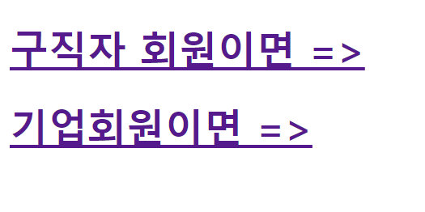
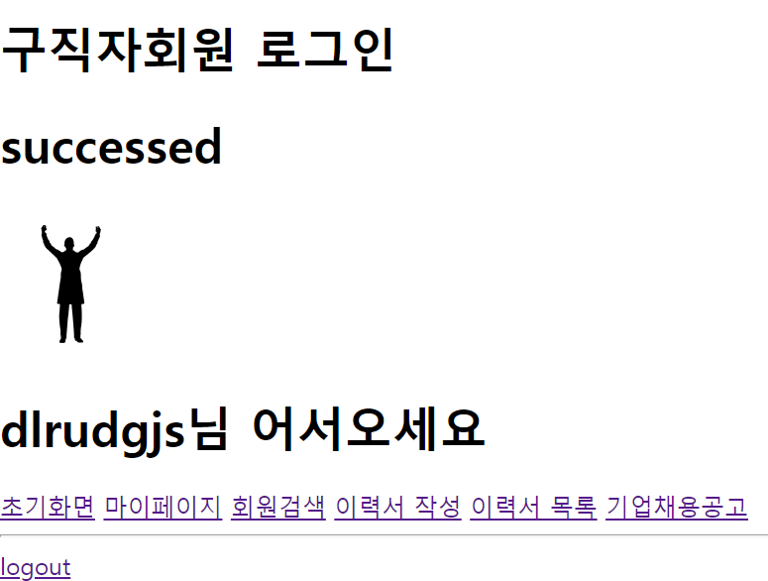
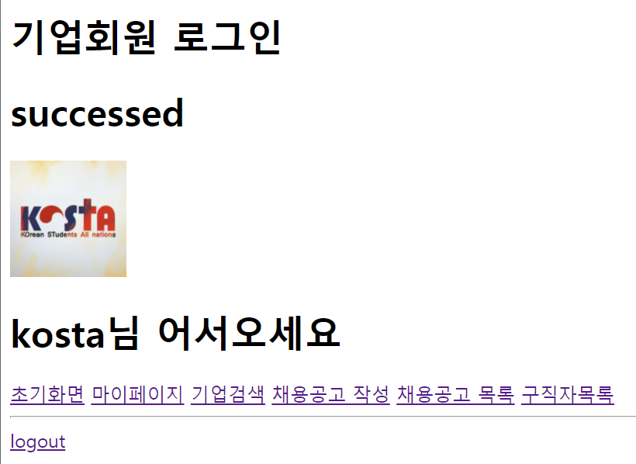
Board(folder)
Board/Insert. Jsp Board/update.jsp
Board/selectOne.jsp
Board/selectAll.jsp
Boardcontroller
DB
BoardVO BoardDAO
BoardDAOimpl
create table board(
num number constraint board_num_pk primary key,
title varchar(40) unique,
content varchar(5000) not null,
writer varchar(40) not null,
wdate date default sysdate,
cnt number default 0,
lik number default 0
);
Index.ssp, menu.jsp
로그인 전
Start.do = 구직자회원으로 로그인
구현방식은 수업코드참고 insert.jsp
c_Start.do = 기업회원으로 로그인
로그인 후
구직자회원 로그인
기업회원 로그인
successed
successed
아이디님 환영합니다.
아이디님 환영합니다.
menu
menu
logout
logout

Slide 5
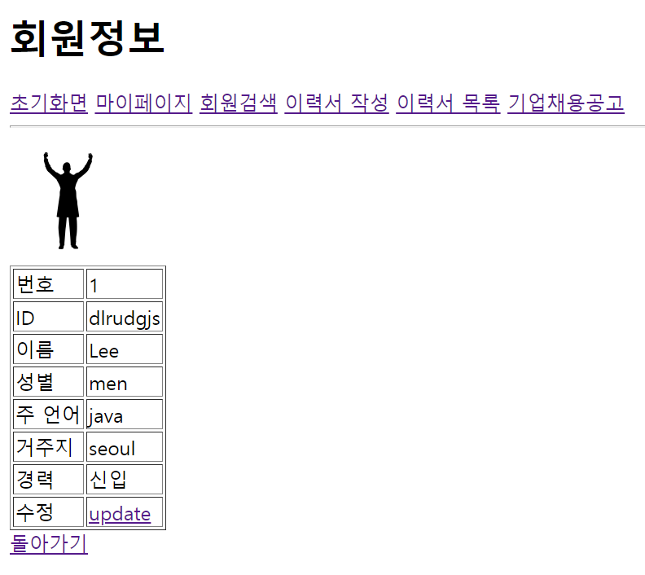
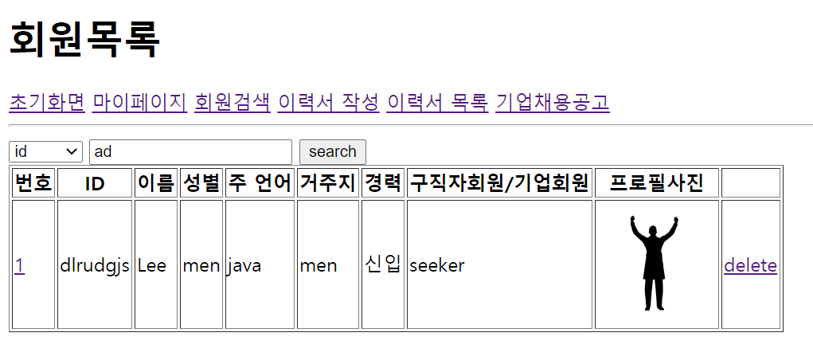
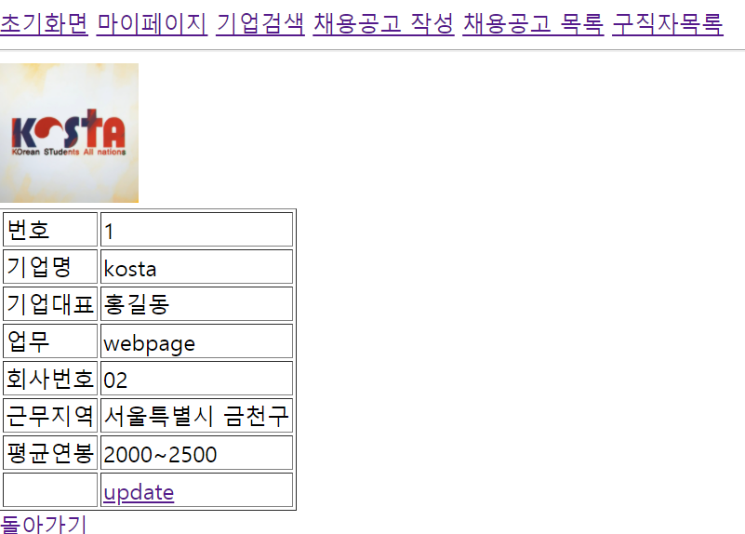
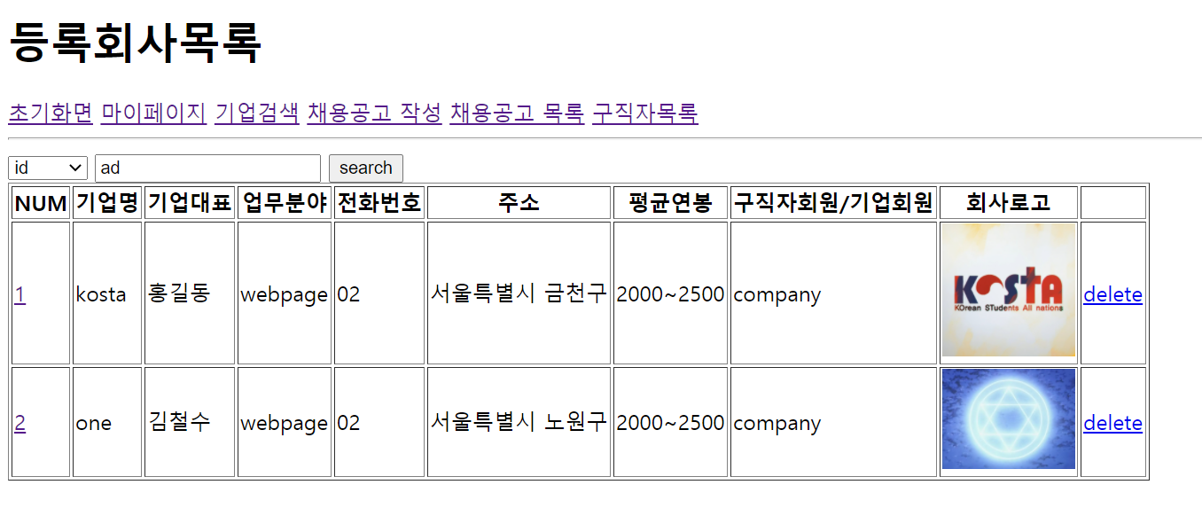
구직자회원:마이페이지(seeker)
구직자회원:회원검색 (seeker)
기업회원:마이페이지 (company)
기업회원:회원검색 (company)

Slide 6
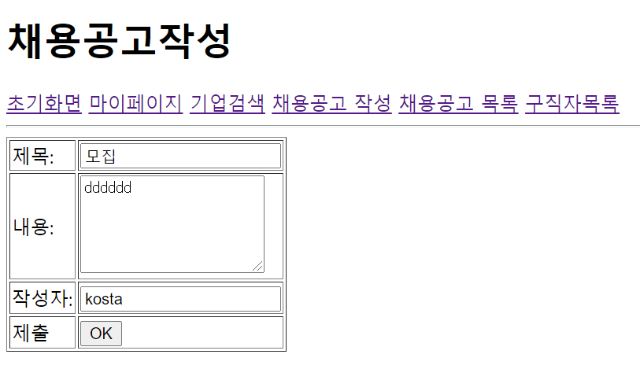
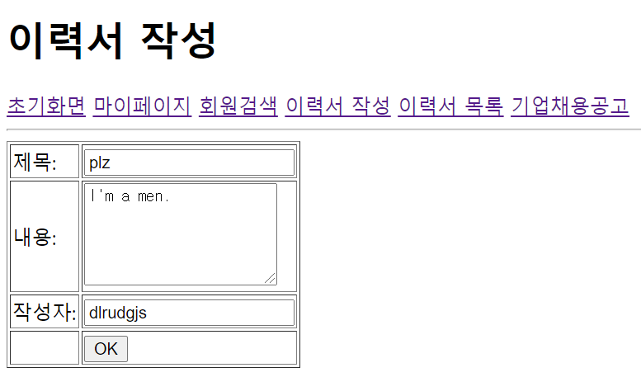
기업회원:채용공고작성(cboard)
구직자회원:이력서작성(sboard)

Slide 7
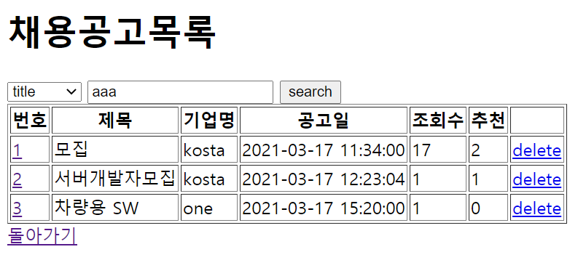
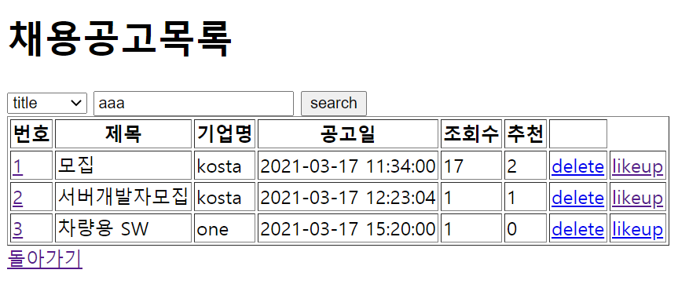
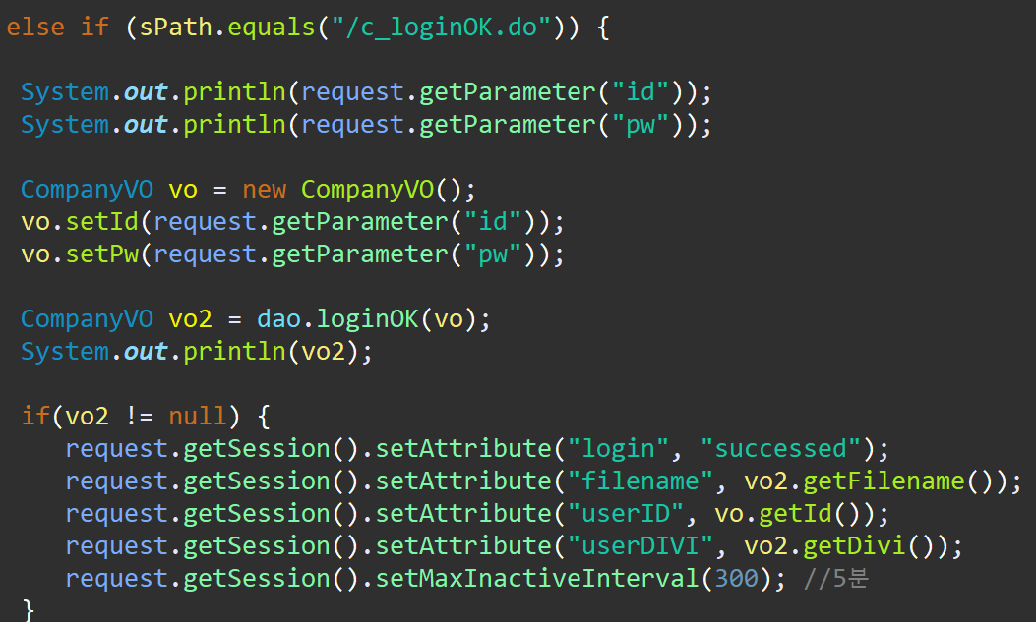
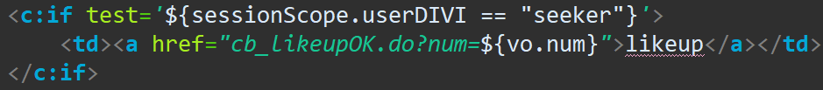
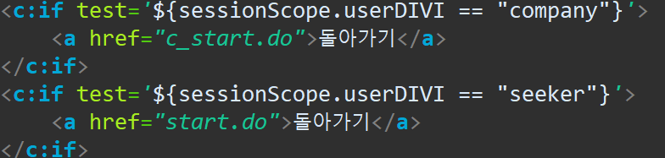
기업회원:채용공고목록(cboard)
구직자회원:이력서목록(cboard)
구직자회원일때만 추천 수 올리기 가능

Slide 8
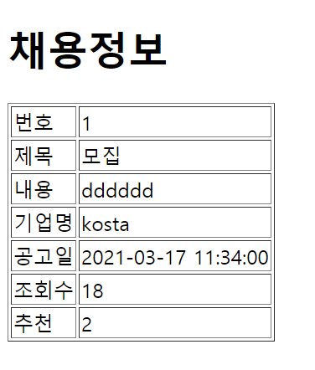
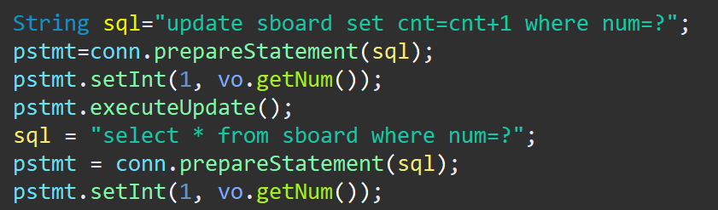
DAOimp

Slide 9
감사합니다.

